Slide 1
DHCP
Dynamic Host Configuration Protocol
  Typically there have been 3 ways of providing and obtaining information for a host or system.
  Enter the information by hand
  Have a system obtain the information using a network service
  Use an algorithm to automatically determine it
  When a DHCP request is made the information provided to the system or server can be
  Name of the client
  Lease duration
  Copy of IP addressed previously used…etc

Slide 2
DHCP
Dynamic Host Configuration Protocol
  Before DHCP there was BOOTP therefore there still needs to be a compatibility between them.
  DHCP builds upon the BOOTP (Bootstrap Protocol)
  It is considered an Application Layer protocol
  BOOTP is implemented using the User Datagram Protocol (UDP) as transport protocol, port number 67 is used by the (DHCP) server to receive client requests and port number 68 is used by the client to receive (DHCP) server responses. BOOTP operates only on IPv4 networks.

Slide 3
DHCP
Dynamic Host Configuration Protocol
  Servers can manage one or more ranges of IP addresses
  When TCP/IP is configured on client computer
    The Obtain an IP address automatically option is the only necessary set-up element
Next time workstation attempts to access network
  It broadcasts a DHCP address request to the network because it has no IP address
All DHCP servers present on same broadcast domain
  Receive request and send back message that indicates a willingness to grant an address lease

Slide 4
DHCP
Dynamic Host Configuration Protocol
Client
  Accepts address lease offer and sends packet to server that extended offer
In reply
  Server offers an IP address for a specific period of time that the client uses thereafter
When half the lease period expires
  Client attempts to renew the lease

Slide 5
DHCP
Dynamic Host Configuration Protocol
Leases
  “Loans” of an address for a specific amount of time
Leases that range from one to three weeks
  Typical on networks in which machines seldom move and the workforce is stable
Lease periods
  Average between one and three days for networks on which roving workers come and go regularly
Lease periods of four to eight hours
  Common on ISP networks

Slide 6
DHCP
Dynamic Host Configuration Protocol
DHCP client
  Enabled at client machine when you select the Obtain an IP address automatically option
DHCP server
  Manages address pools and configuration data
DHCP relay agent
  Intercepts address requests on local cable segment
  Repackages requests as a unicast to one or more DHCP servers

Slide 7
DHCP
Dynamic Host Configuration Protocol
How DHCP integrates with DNS
  Server addresses are advertised using DNS
  All address updates must be entered manually
  Client addresses usually come into play only when
    e-mail addresses of the form user@domain.name must be resolved

Slide 8
DHCP
Dynamic Host Configuration Protocol
DHCP Discovery
  Occurs when DHCP client broadcasts a request for an IP address
DHCP Discovery
  Relies on an initial DHCP broadcast
DHCP servers
  PING an address before offering it to the client
Windows clustering
  Allows two or more servers to be managed as a single system

Slide 9
DHCP
Dynamic Host Configuration Protocol
Uses four packets
  DHCP Discover packet
  DHCP Offer packet
  DHCP Request packet
  DHCP Acknowledgment packet

Slide 10
DHCP
Dynamic Host Configuration Protocol
Discover Packet
During DHCP Discovery process
  Client broadcasts Discover packet that identifies client’s hardware address
  Header contains
    Source IP address 0.0.0.0
Preferred address
  Typically the last address the client used

Slide 11
DHCP
Dynamic Host Configuration Protocol
Offer Packet
Send by DHCP server to offer IP address to DHCP client
Offer packet
  Includes IP address that is offered to the client and,
  Sometimes, answers to the requested options in the DHCP Discover packet

Slide 12
DHCP
Dynamic Host Configuration Protocol
Request Packet
Once Offer packet is received
  Client can either accept offer by issuing a DHCP Request packet, or
  Reject offer by sending a DHCP Decline packet
Typically
  Client sends a Decline only if it receives more than one Offer

Slide 13
DHCP
Dynamic Host Configuration Protocol
Acknowledgement Packet
Sent from server to client to indicate the completion of the four-packet DHCP Discovery process
Response
  Contains answers to any configuration options requested by client in the previous Request packet

Slide 14
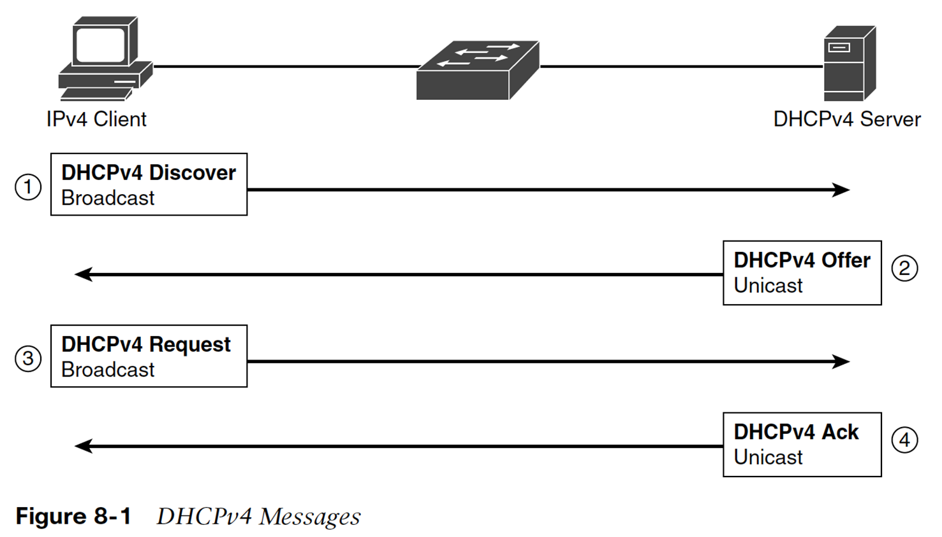
DHCP
Dynamic Host Configuration Protocol
Acknowledgement Packet
Sent from server to client to indicate the completion of the four-packet DHCP Discovery process
Response
  Contains answers to any configuration options requested by client in the previous Request packet

Slide 15
DHCP
Dynamic Host Configuration Protocol
IPv6 uses a RS or RA message
  RS – Routing Solicitation
  RA – Routing Advertisement
  GUA – Global Unicast Address
  LLA – Link Layer Address

Slide 16
DHCP
Dynamic Host Configuration Protocol
IPv6
  Stateful autoconfiguration of IPv6 is the equivalent to the use of DHCP in IPv4. It requires a DHCPv6 service to provide the IPv6 address to the client device and that both client device and server maintain the "state" of that address (i.e. lease time, etc).
  Stateless autoconfiguration of IPv6 allows the client device to self configure it's IPv6 addreess and routing based on the router advertisements.
  A network can use both stateful and stateless autoconfiguration at the same time, they are not mutually exclusive.

Slide 17
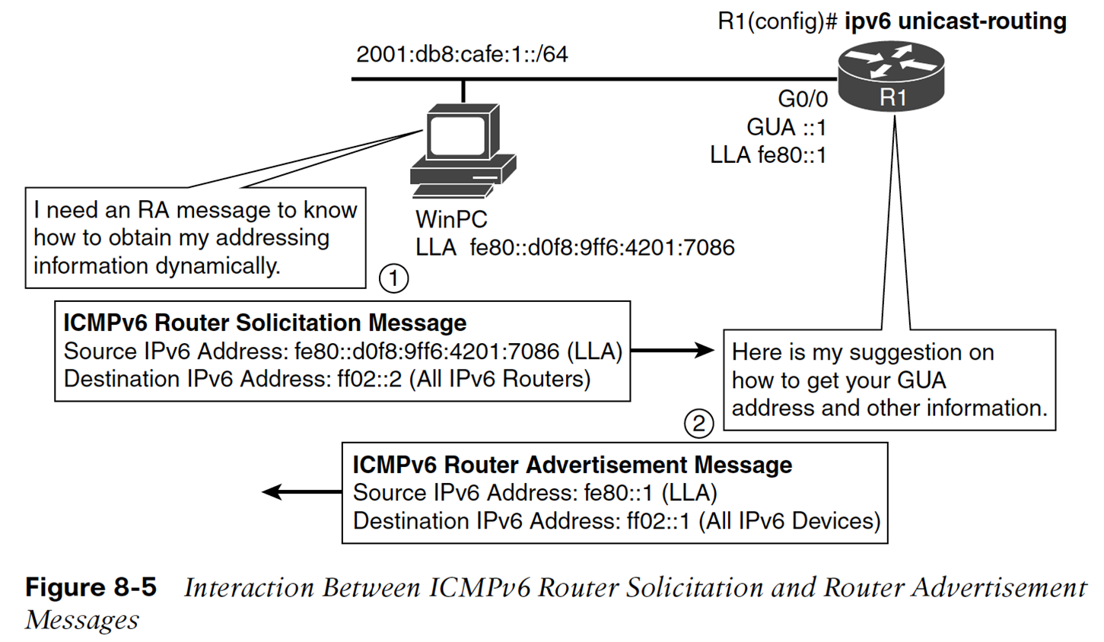
DHCP
Dynamic Host Configuration Protocol

Slide 18
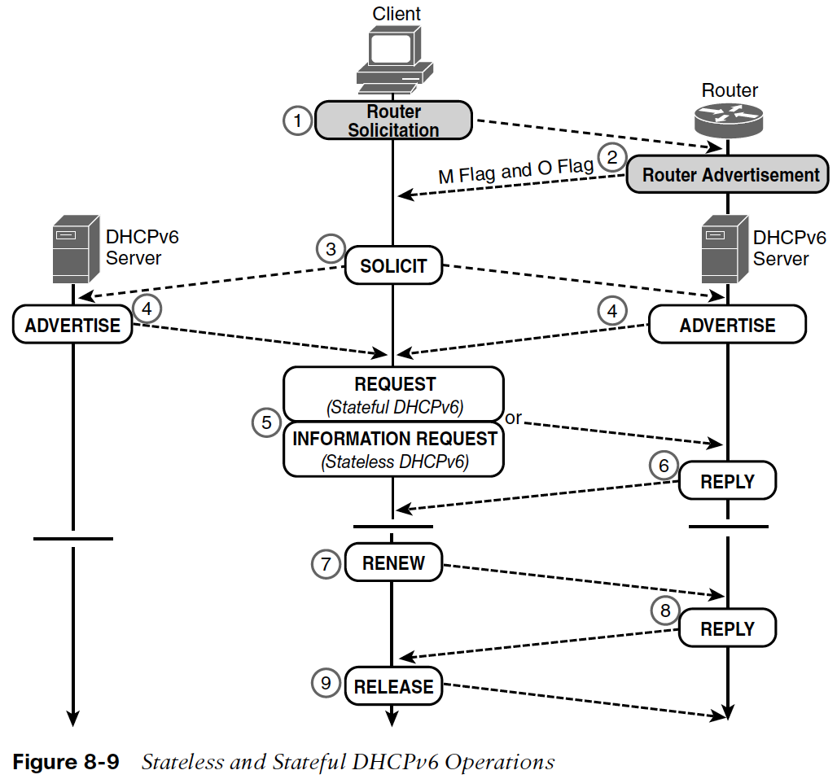
DHCP
Dynamic Host Configuration Protocol

Slide 19
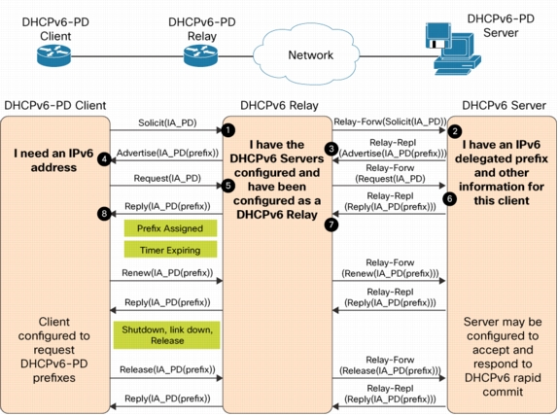
DHCP
Dynamic Host Configuration Protocol

